Slide 1


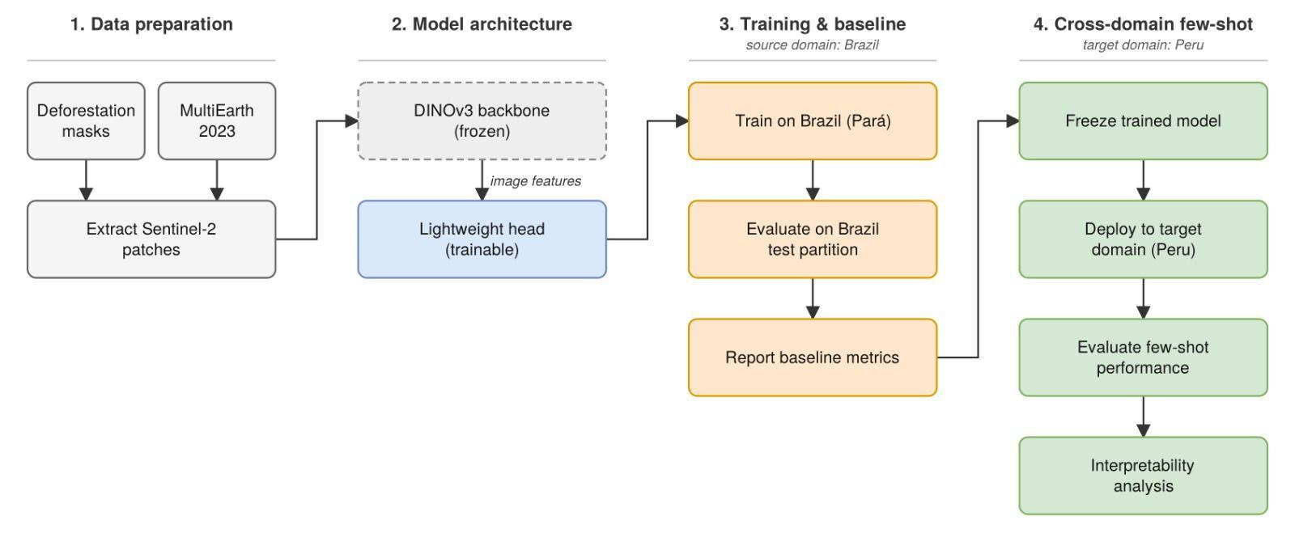
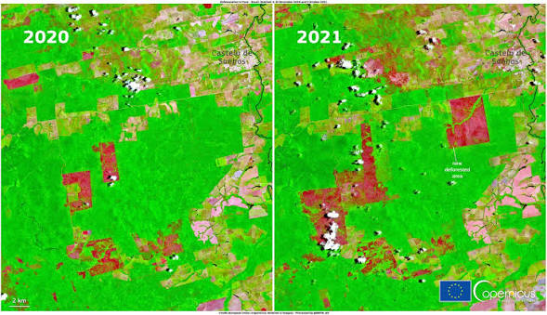
Workshop on Artificial Intelligence and Machine Learning Applications
Does self-supervised pretraining help detect deforestation in a new country? Transferring frozen DINOv3 vs. a supervised U-Net from Brazil to the Peruvian Amazon
Christian Carhuancho¹ • Jorge Chamorro¹ • Jorge Fatama¹
¹Pontificia Universidad Catolica del Peru, Lima, Peru
MOTIVATION & RESEARCH PROBLEM
OBJECTIVES / CONTRIBUTION
This research addresses the critical need for scalable Amazonian deforestation monitoring by overcoming the reliance on extensive local retraining data. Using Sentinel-2 satellite imagery, the study leverages the DINOv3 foundational vision model to train a detection system in Brazil and evaluate its cross-regional transferability in Peru via zero-shot and short fine-tuning techniques. Ultimately, this work demonstrates how advanced artificial intelligence models can generalize across geographical borders, enabling more rapid and practical deployment for environmental monitoring.
The primary objective of this study is to detect Amazonian deforestation across geographic borders by training a model on Sentinel-2 imagery from Brazil and evaluating its transferability to Peru using zero-shot and few-shot techniques. To achieve this, the approach extracts robust image features utilizing a frozen DINOv3 foundational vision model and efficiently trains a lightweight detection head on Brazilian reference data. Subsequently, the system assesses cross-domain performance and interpretability within the Peruvian target domain. The key contribution of this work lies in demonstrating that foundational vision models can successfully generalize across distinct ecological regions, offering a scalable, rapid-response tool for environmental monitoring that bypasses the traditional bottleneck of requiring extensive, region-specific annotated data.
METHODOLOGY
RESULTS & DISCUSSION
ACKNOWLEDGMENTS / FUNDING
CONTINUE THE CONVERSATION
Thanks to Meta for providing the most calibrated model of DINOv3.
Contact: a20172665@pucp.edu.pe
BRING YOUR RESEARCH. SHARE YOUR IDEAS. JOIN THE CONVERSATION.
WAIMLAp 2026 • November 18–20, 2026 • Lima, Peru • waimlap.org

